Slide 1
Week 1 RNN

Slide 2
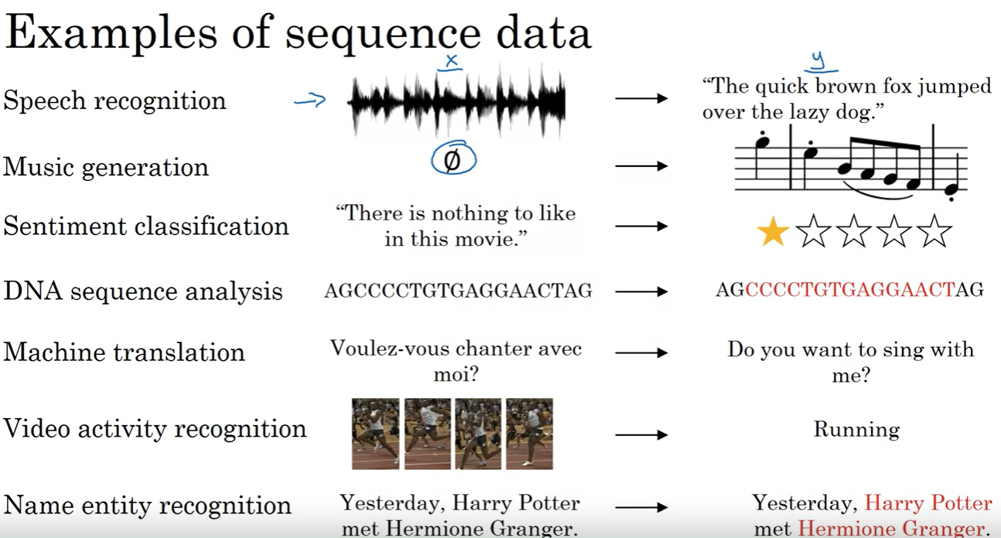

Slide 3
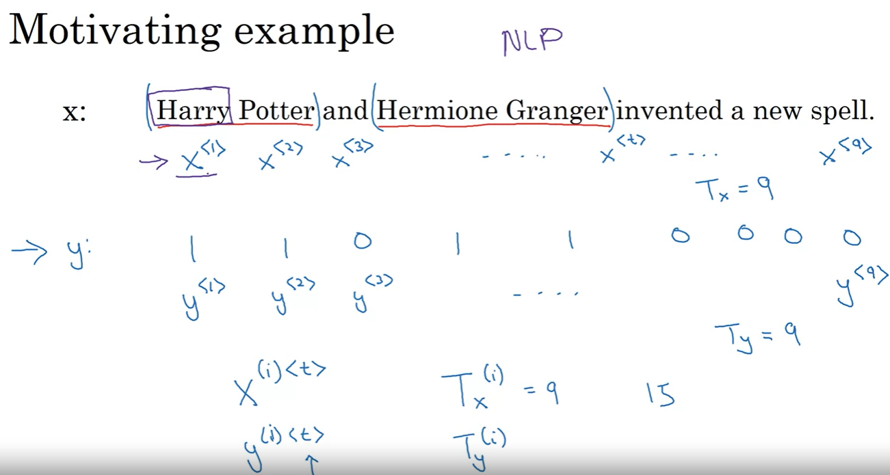

Slide 4
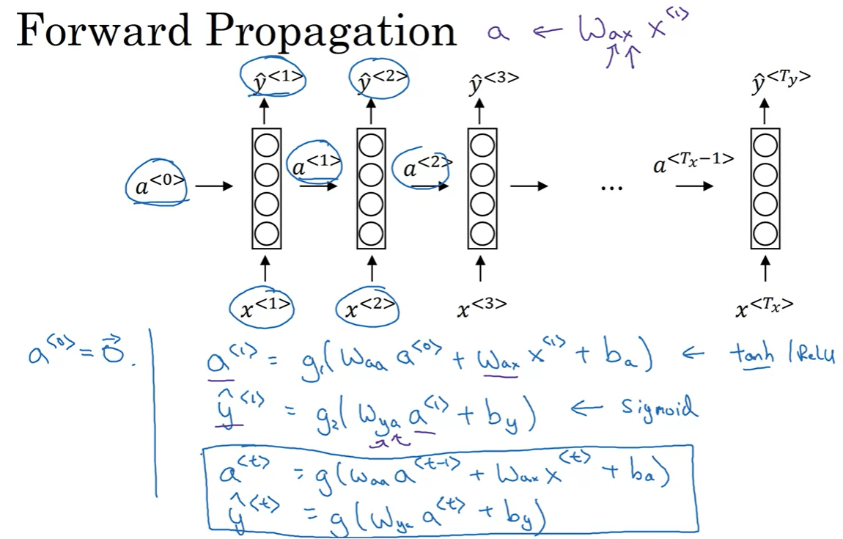
apply another set of parameters to get y from a, so it can be in the desired output format?

Slide 5
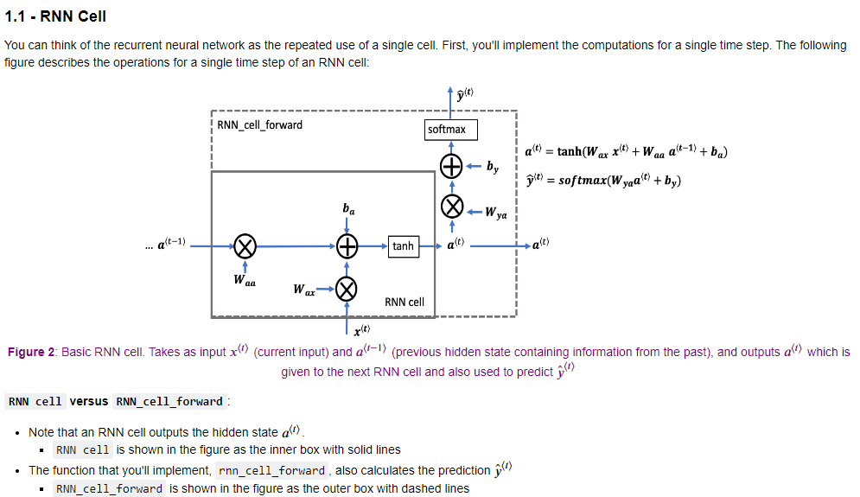

Slide 6
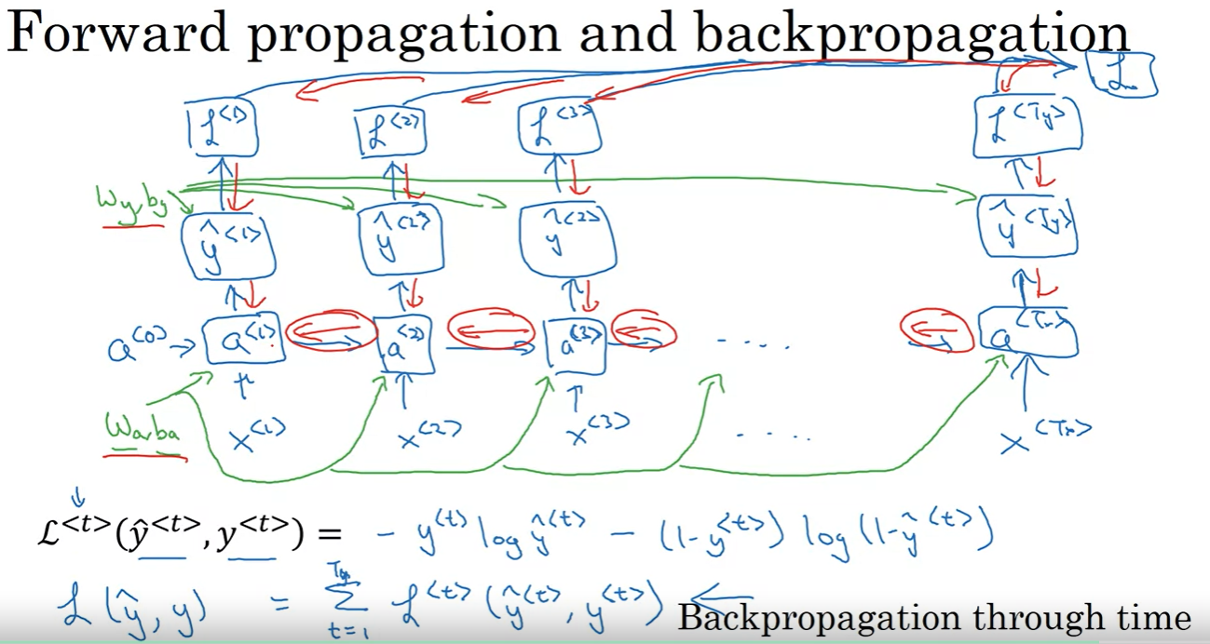

Slide 7
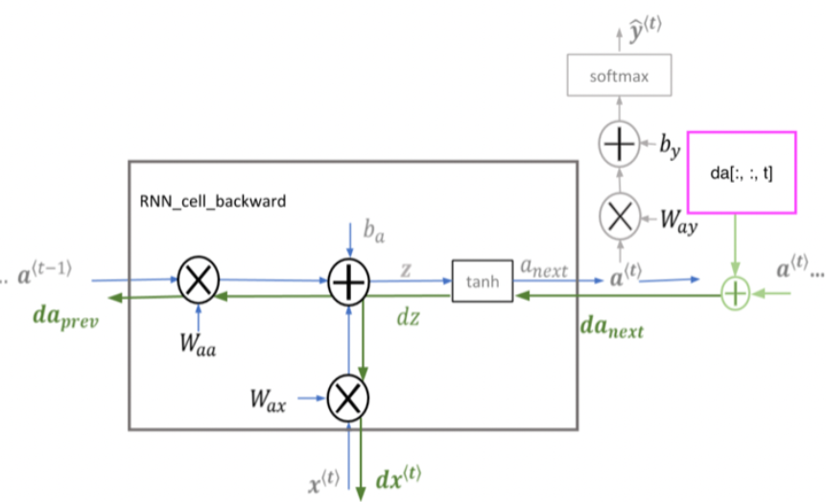
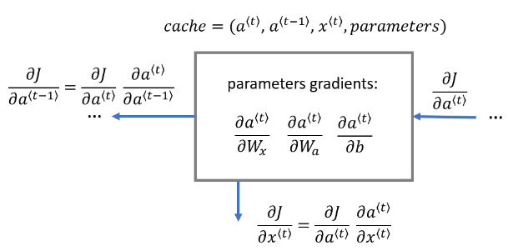
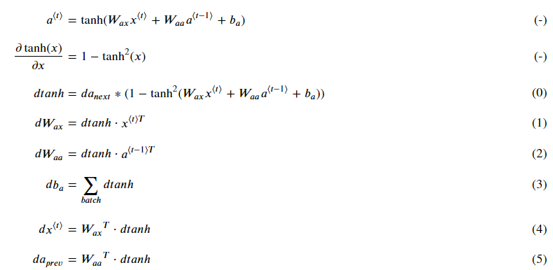
dtanh is actually dz,
where z = (Wax ⋅ x_t + Waa ⋅ a_(t-1) + b_a)

Slide 8
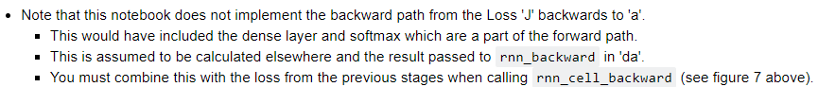


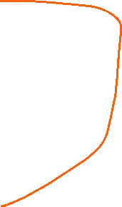

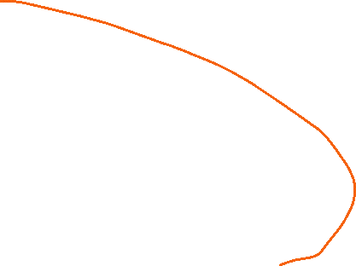
The overall d_at is influenced by two parts (d_a_prevs + da computed from loss, which is 0 at the beginning of backprop, i.e., the most right side)

Slide 9
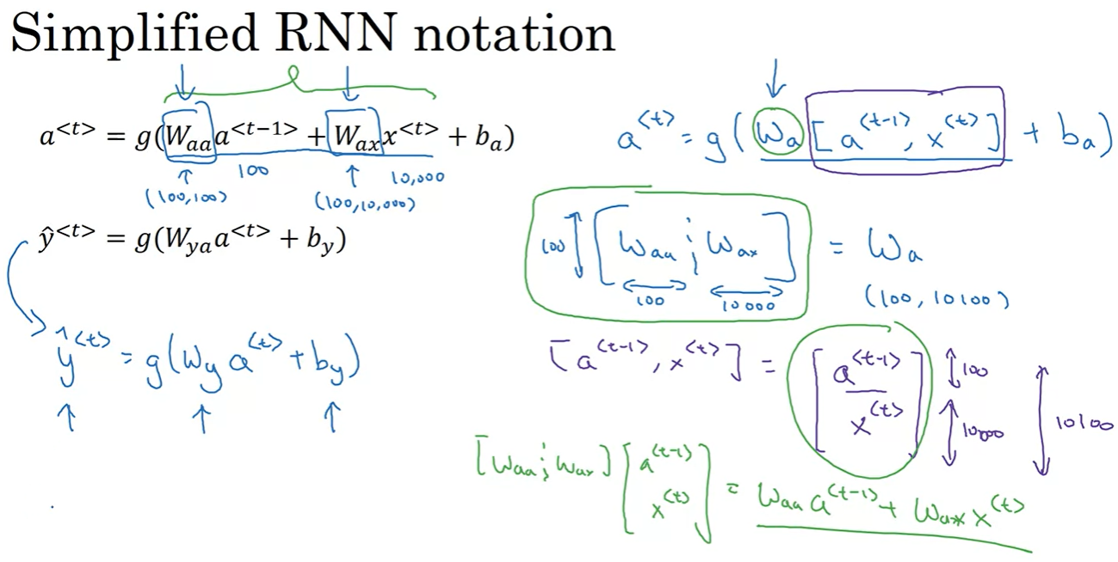

Slide 10
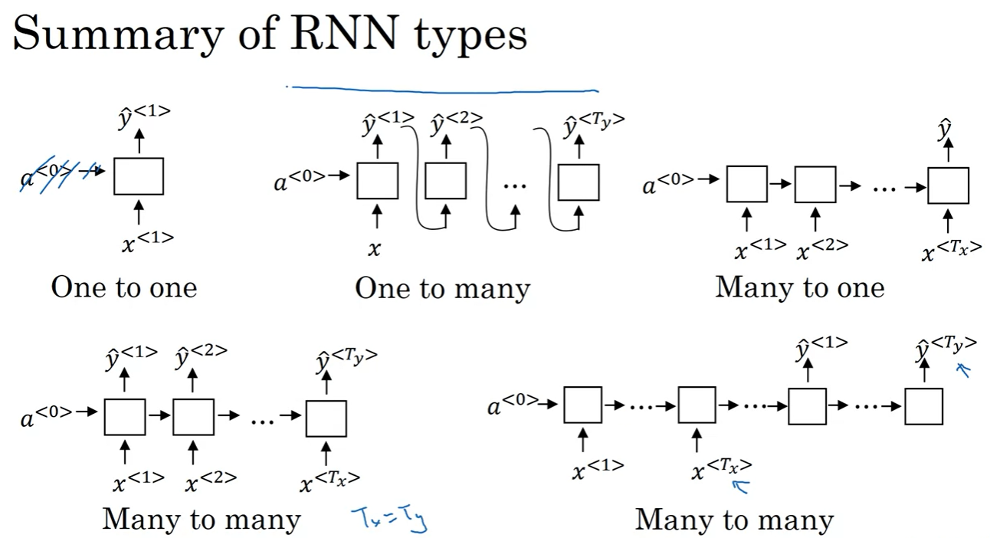

Slide 11
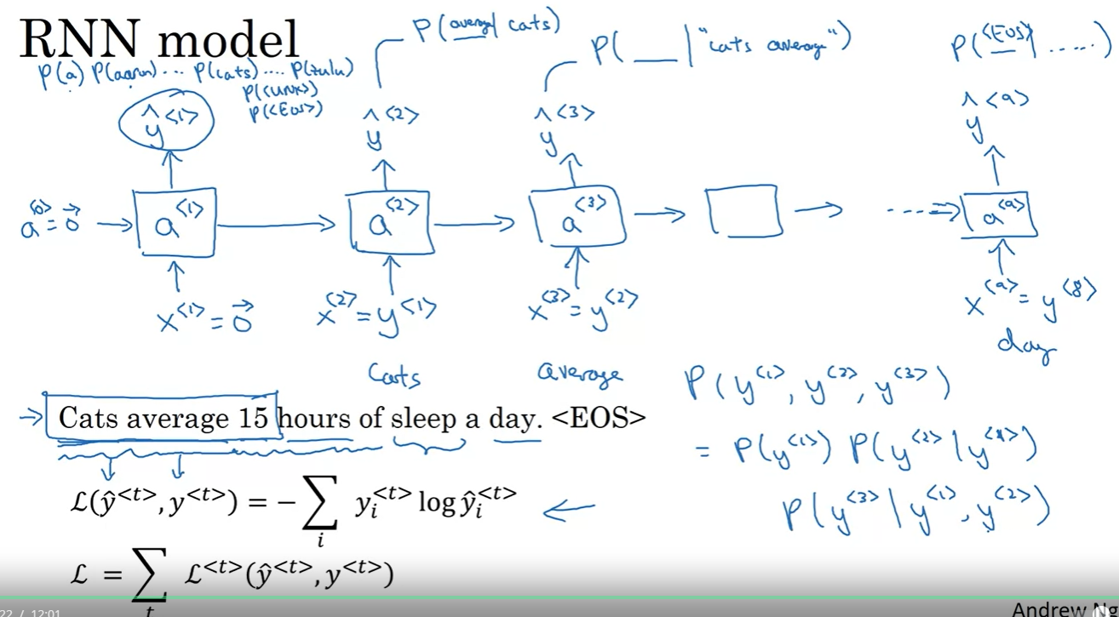
using the previous values to predict the next value!

Slide 12
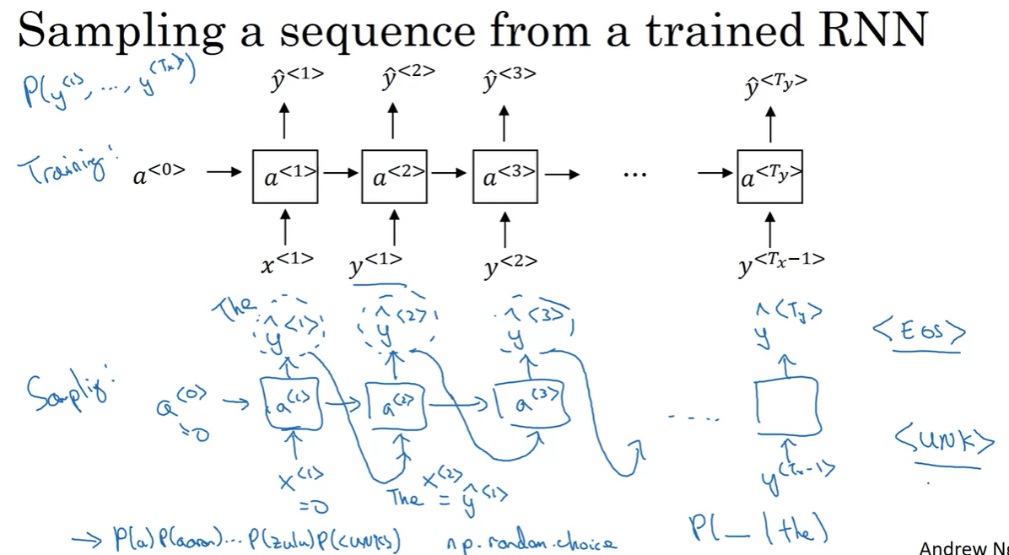

Slide 13
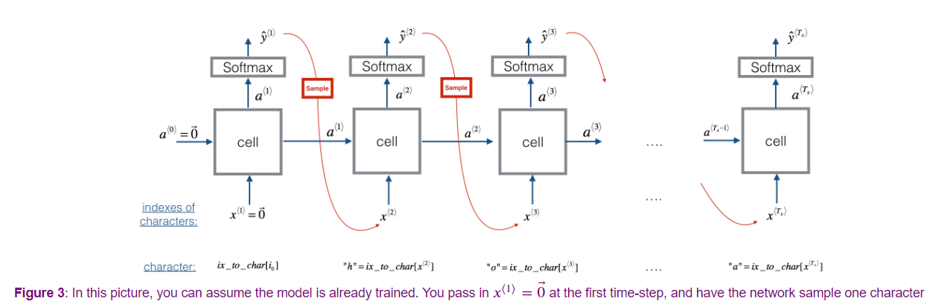

Slide 14
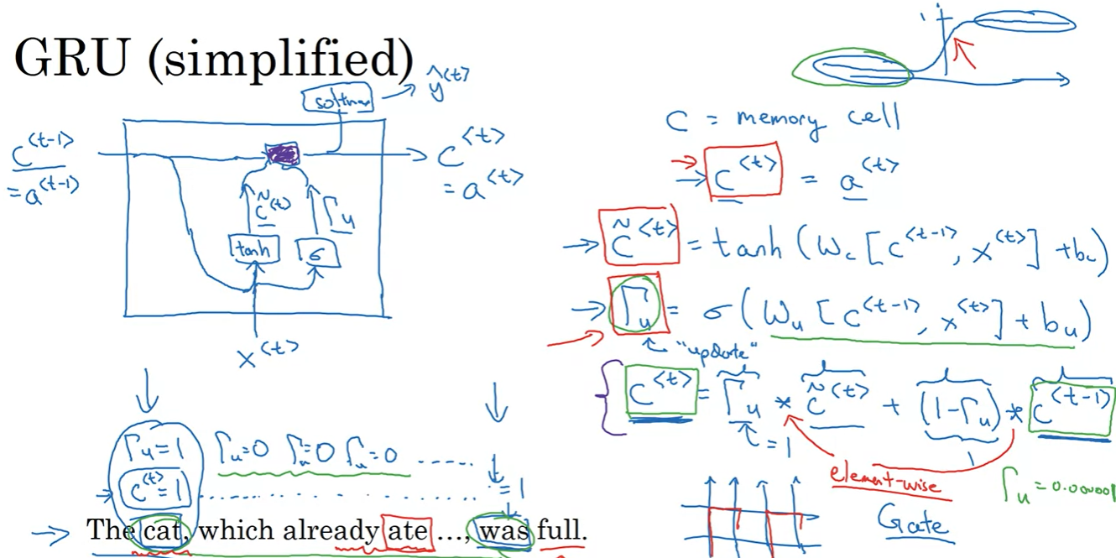

Slide 15
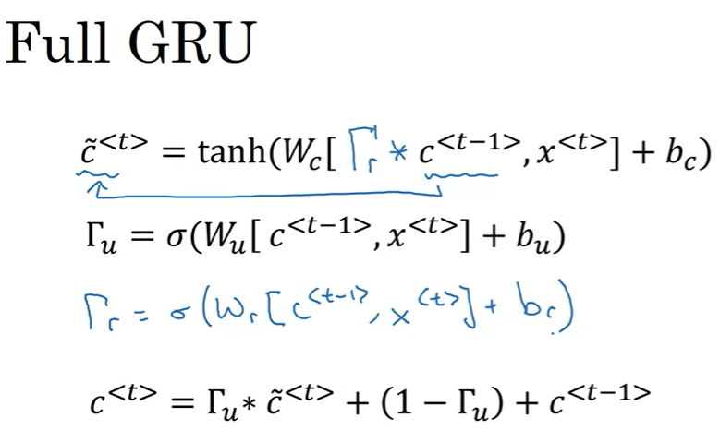

How relevant c^<t - 1> is to compute c(tilde)^<t>

Slide 16
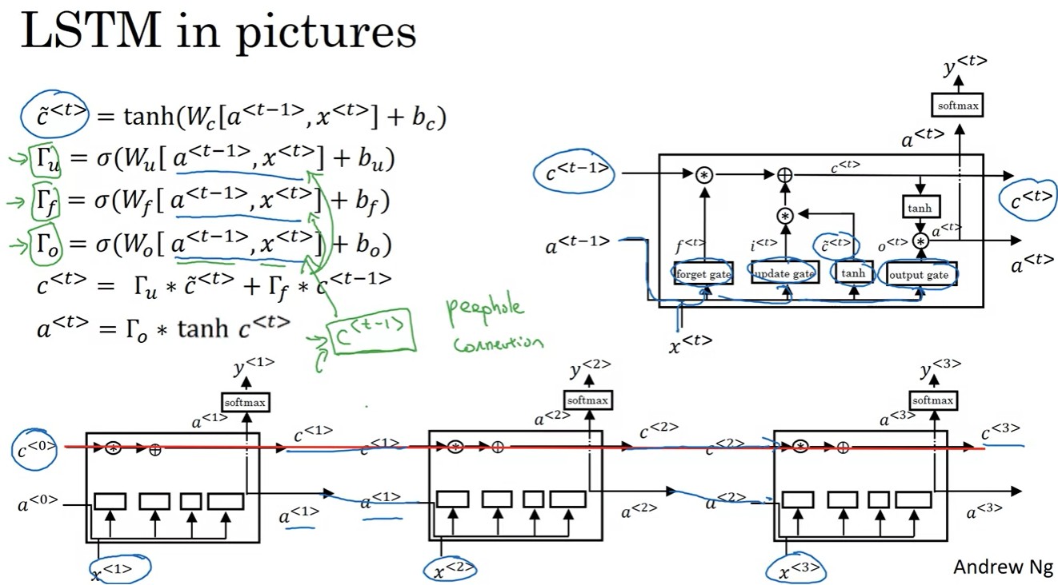

Slide 17
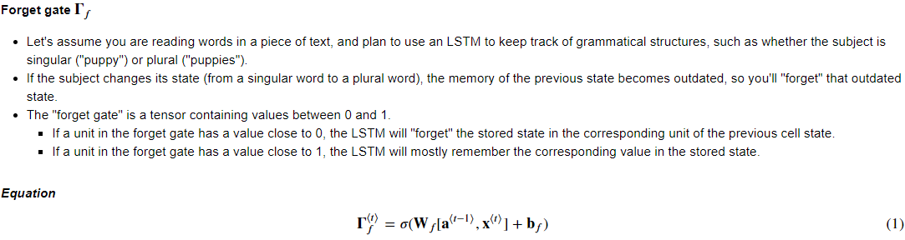
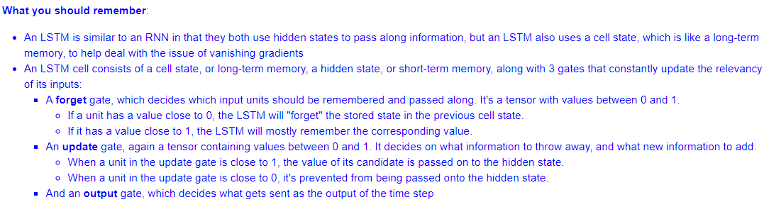

Slide 18
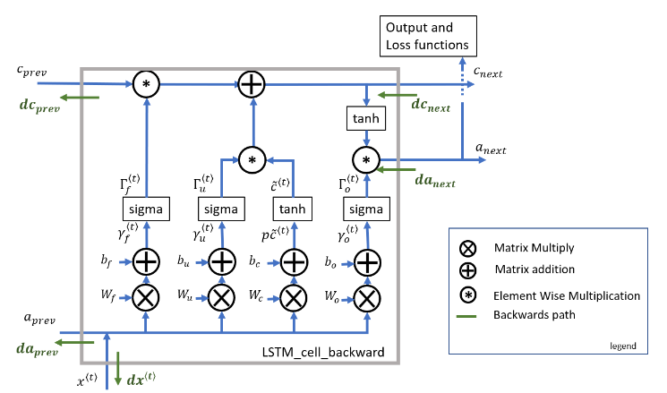

Slide 19
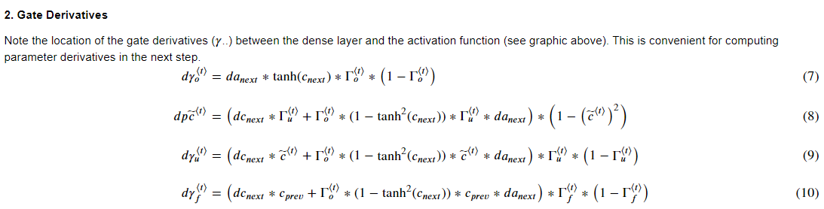
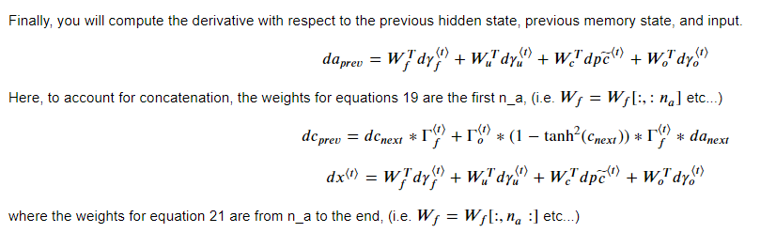
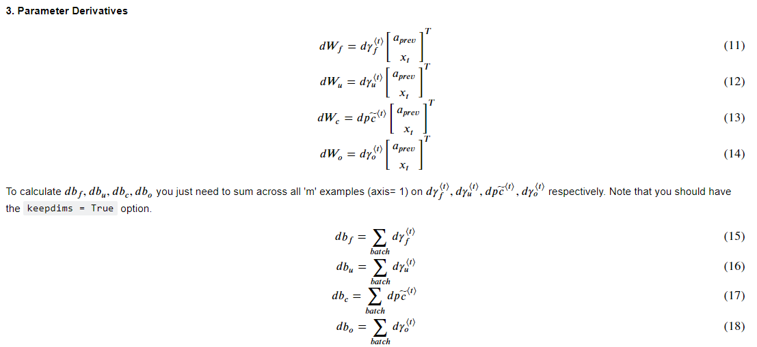

Slide 20
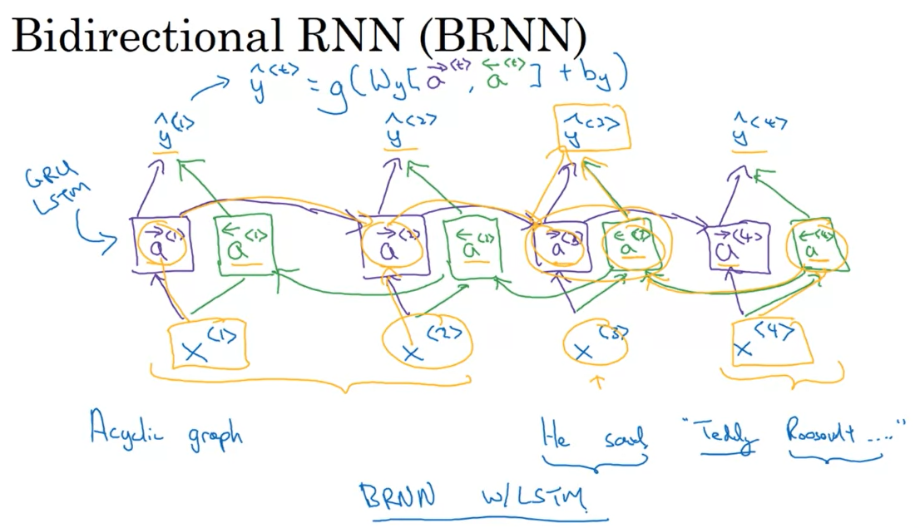

Slide 21
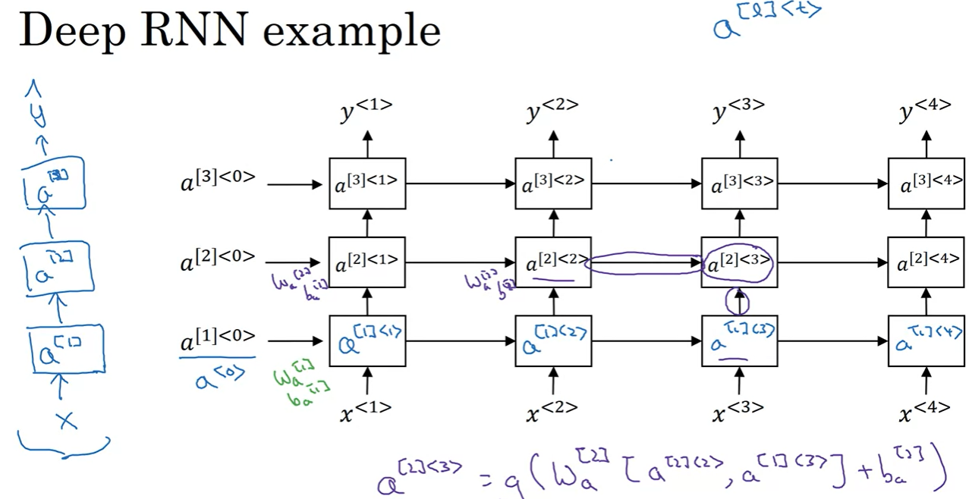
Usually just a few layers, because RNN already has the temporal dimension

Slide 22
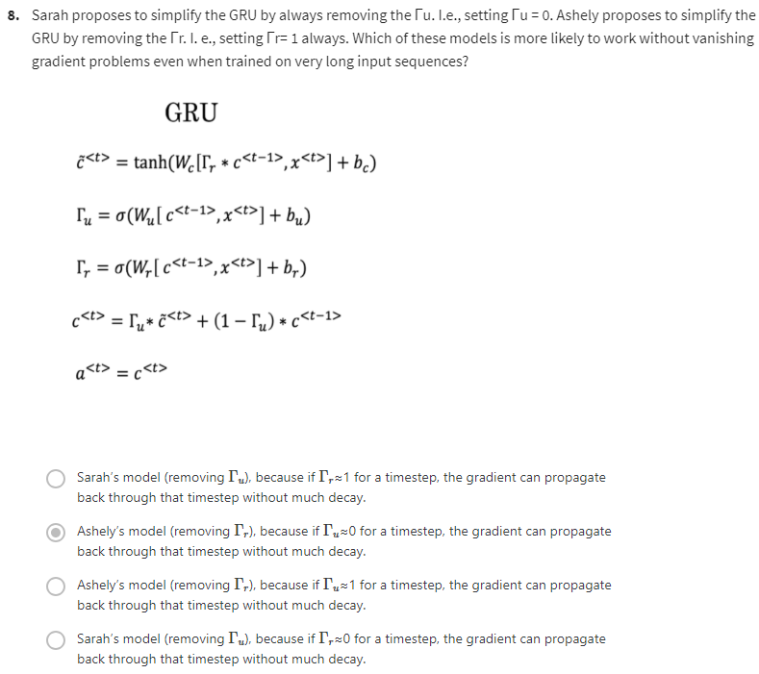

Slide 23
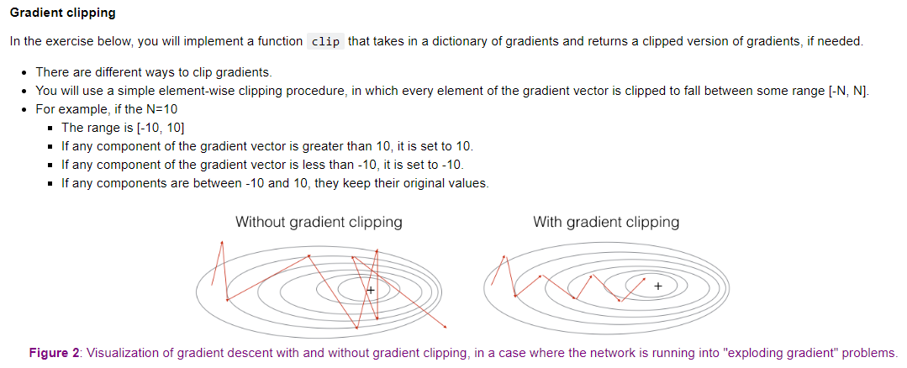

Slide 24
Improvise a Jazz Solo with an LSTM Network
Note that the training model djmodel()is created using global defined layers (LSTM_cell = LSTM(n_a, return_state = True); densor = Dense(n_values, activation='softmax') ) so all units share the same weights.
Later, when building the reference model music_inference_model, we still use the LSTM cell with the learned weight from djmodel().

Slide 25
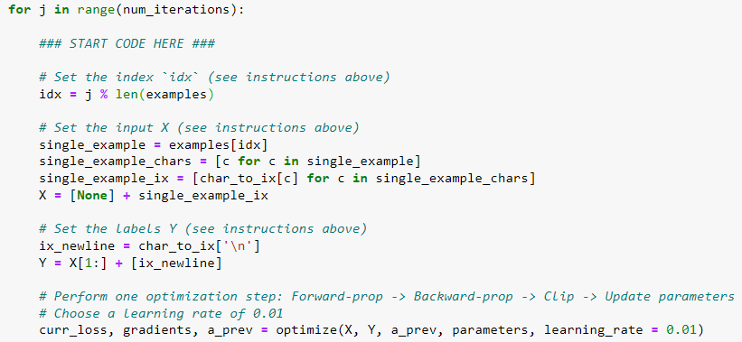

Reuse examples
Y is shifted to right by 1 position, so there is no None at the beginning, and also end with ‘\n’

Slide 26
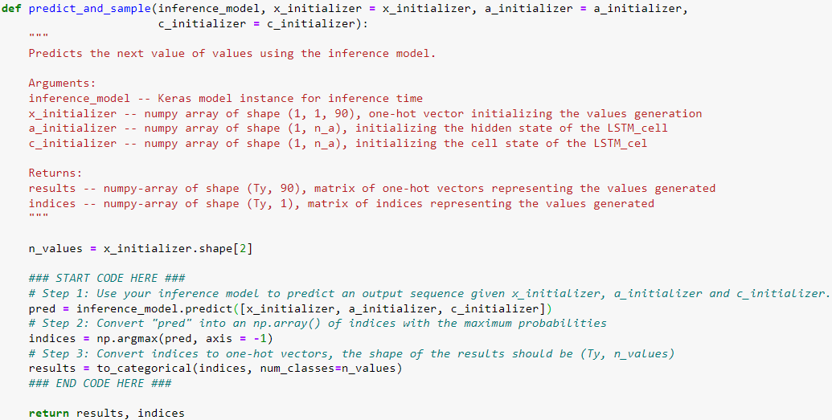

# Ty is set to be 50
inference_model = music_inference_model(LSTM_cell, densor, Ty = 50)
x_initializer = np.zeros((1, 1, n_values)) # n_values == 90
a_initializer = np.zeros((1, n_a)) # n_a == 64
c_initializer = np.zeros((1, n_a))
Pred will is a list of length 50 (equal to Ty) , each element is of shape (1, 90), which are the predicted probabilities for each of the 90 notes (values)

Slide 27
Week Word Embedding

Slide 28
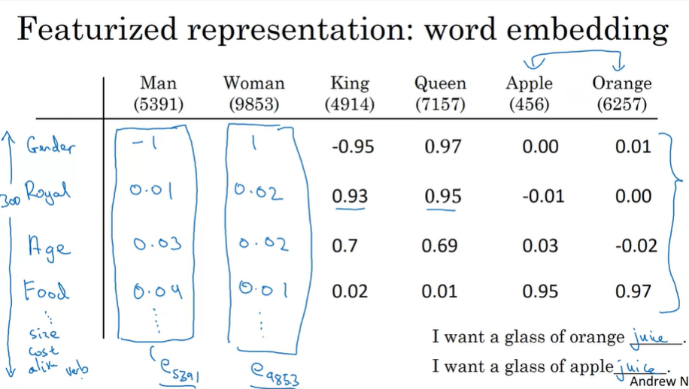

Slide 29
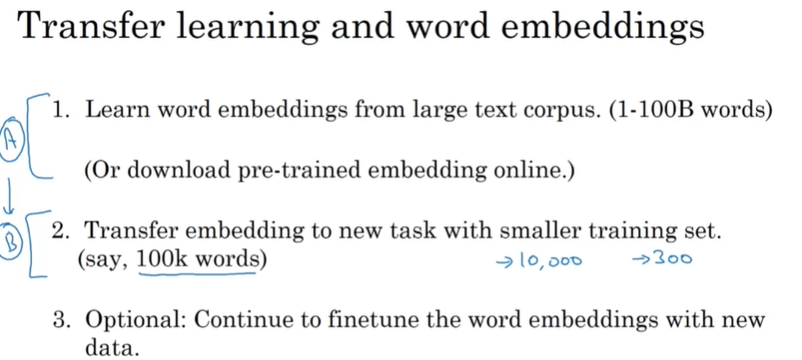

Slide 30
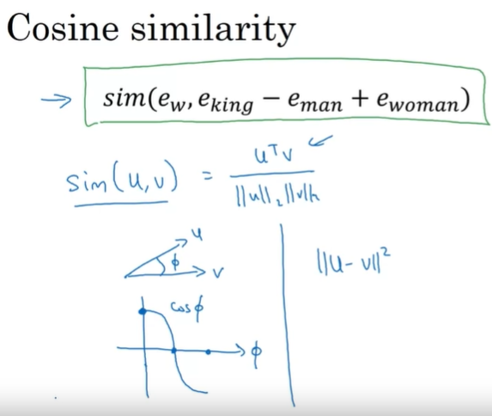
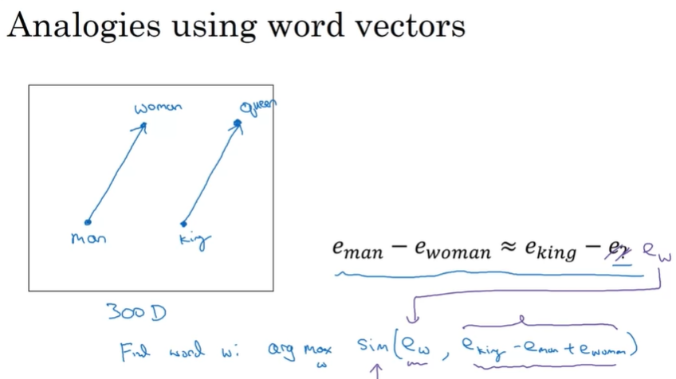


comparing vectors in terms of orientation and not in terms of magnitude

Slide 31
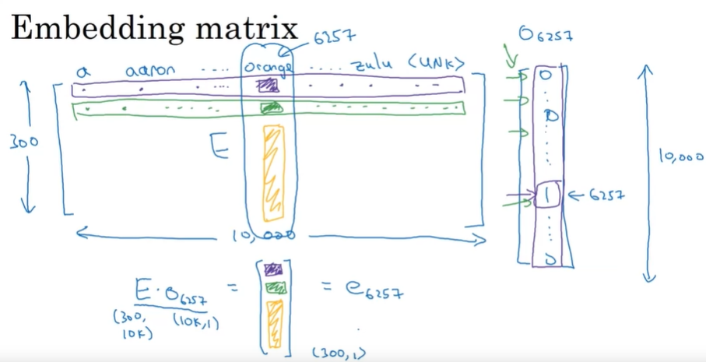

Slide 32
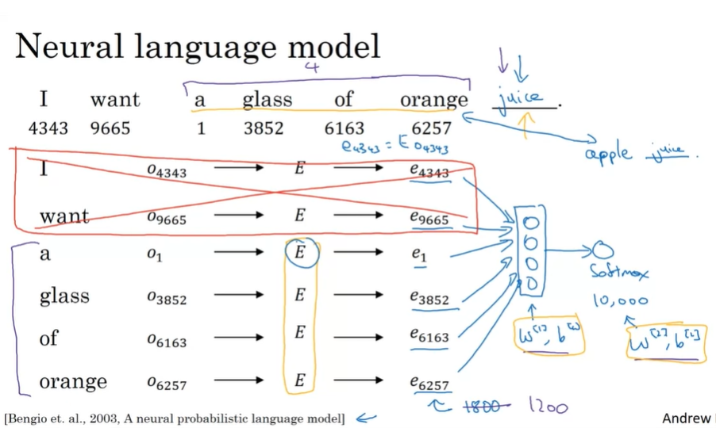
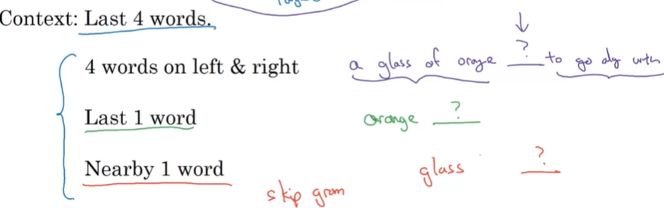

Slide 33
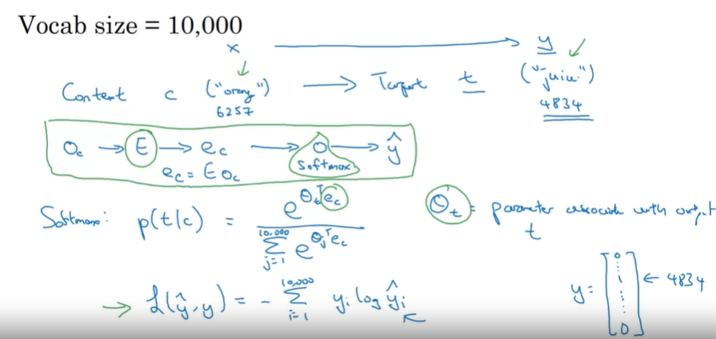
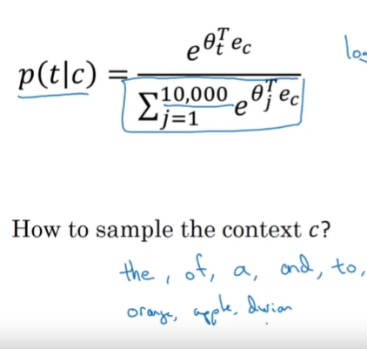
Skip gram
Easier to understand when using theta_c
Need to choose c that balance common and uncommon words

Slide 34
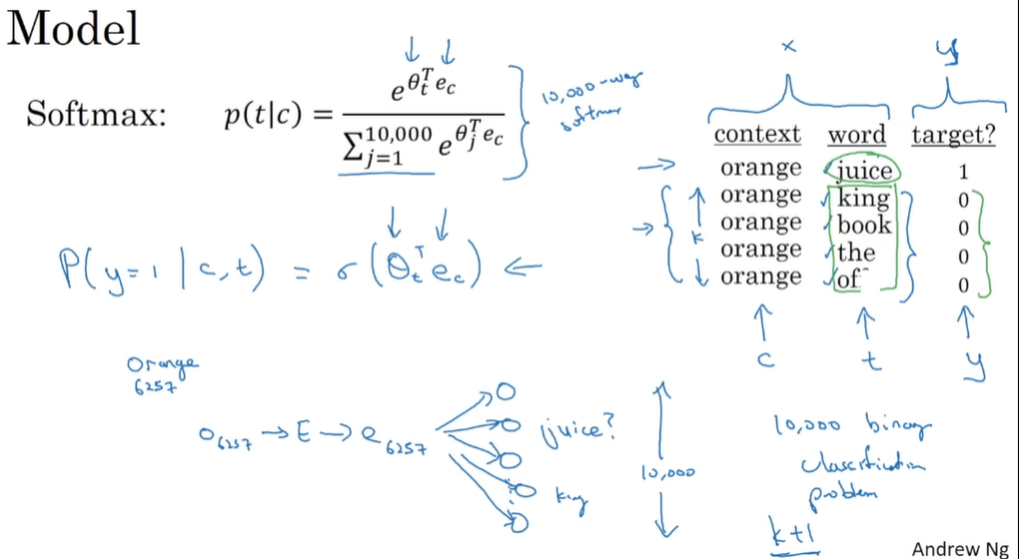

Change to binary classification problem

Slide 35
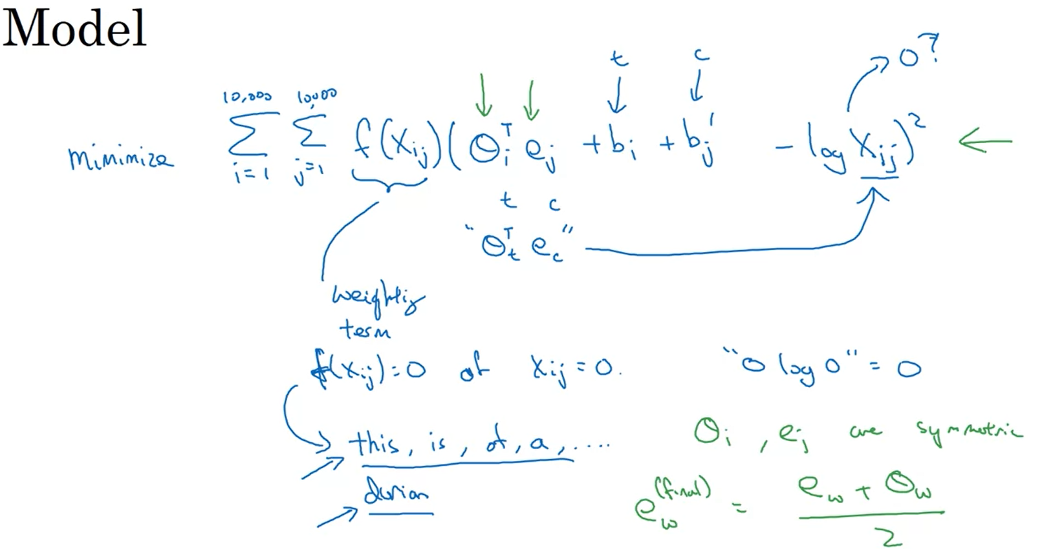
Bias term
GLoVe

Slide 36
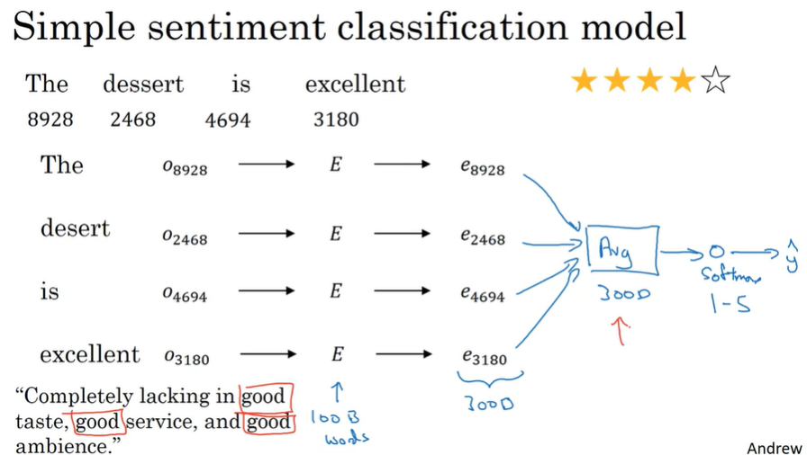

Slide 37
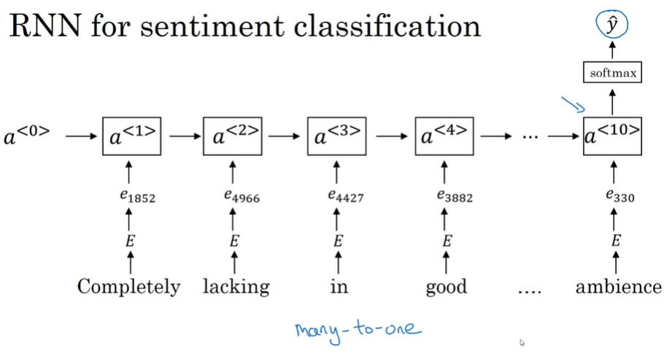

Slide 38
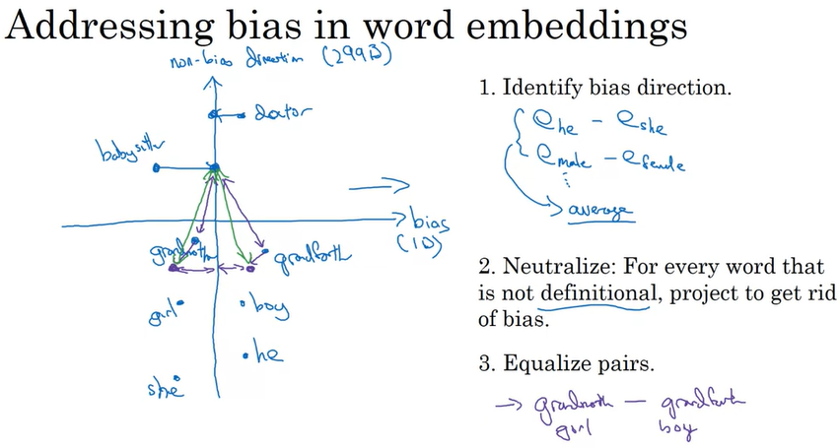

Slide 39
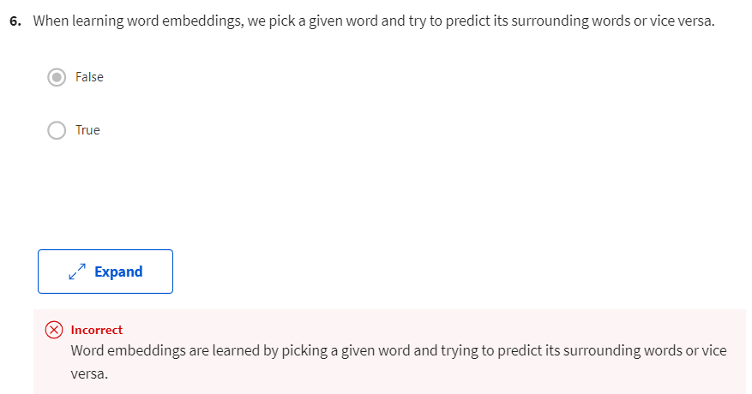
Skip-gram
Continuous Bag of Words

Slide 40
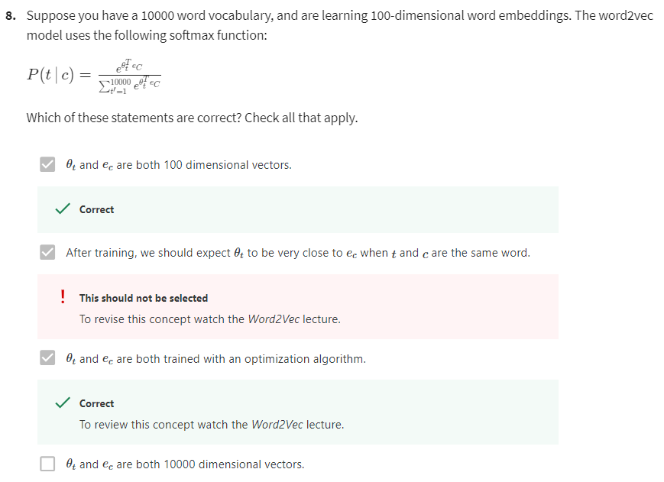
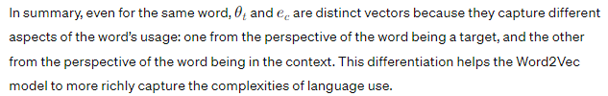



Slide 41
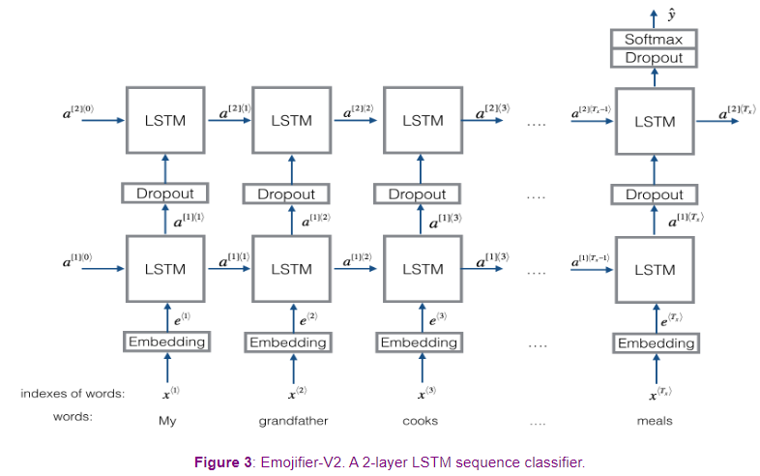


Set return_sequence=False
Works like a look-up table
Set return_sequence=True

Slide 42
